Slide 1
AI-NIDS : AI-Powered Network Intrusion
Detection System
Department : Computer Science and Engineering
Team Members: Project Supervisor:
Ms. Madhavi Netke
Chetan Narware (BT22CSD001)
Aman Zade(BT22CSD004)
Kshitij Tripathi(BT22CSD029)

Slide 2
Problem Statement
Evolving Cyber Threats: The Need for AI-Powered Network Intrusion Detection System (NIDS)
Problem Identification :
Rising Cyber Threats – Attacks like DDoS, malware, phishing, and unauthorized access are increasing.
Limitations of Traditional IDS – Rule-based systems fail to detect zero-day attacks and evolving threats
Evasion Techniques – Attackers modify malware patterns to bypass conventional detection
High False Alarms – Manual threat detection leads to alert fatigue and missed intrusions.
Scalability Issues – Large network traffic requires real-time, automated detection

Slide 3
Introduction to AI-Driven Intrusion Detection
Cyber threats are growing in volume and complexity, demanding more advanced defenses beyond traditional methods.
Attacks like DDoS, phishing, and malware pose increasing risks globally.
Traditional IDS rely on signatures and heuristics, limiting detection of novel or zero-day attacks.
AI-NIDS combine machine learning and transformer-based deep learning to improve accuracy and reduce false positives.
These AI models offer real-time, adaptive detection that evolves with emerging threats for faster response and stronger security.
By leveraging AI, organizations can proactively detect anomalies and attacks missed by conventional systems.

Slide 4
Project Objectives
Built AI-powered NIDS with modular, flexible architecture
Integrated ML models: Decision Tree, Random Forest, Logistic Regression, XGBoost
Utilized DistilBERT for advanced deep learning detection
Implemented a React and Flask-based interface for user interaction
Used MongoDB and Firestore for data logging and storage.
Designed a modular pipeline using Kafka for efficient data flow.
Supports live monitoring and offline dataset evaluation

Slide 5
Key Features and Impact
Multi-Model Classification: Uses classical ML models (Decision Tree, Random Forest, XGBoost, Logistic Regression) and DistilBERT for improved intrusion detection accuracy.
Modular & Scalable Architecture: Kafka and Docker enable seamless streaming, scalability, and message queuing.
Interactive Dashboard: React + Flask-based UI for real-time visualization, monitoring, and offline testing via CSV uploads.
Contextual Flow Analysis: DistilBERT applies NLP techniques to network data, enhancing detection of subtle or complex attacks.
Comprehensive Data Handling: MongoDB stores raw and processed flows; Firestore ensures real-time sync with the frontend.

Slide 6
Literature Review: Supervised Learning-Based IDS
Research Paper
Methodology
Output
Gaps
AI-Driven IDS Using CNN-LSTM (2024)
Hybrid CNN for spatial + LSTM for temporal patterns in slow attacks
Effective detection of DoS
High computational cost
Captured long-term flow behavior
Slow inference speed limits real-time use
AI-Enabled Threat Detection using Classical ML Models (2024)
Compared Decision Tree, Random Forest, Logistic Regression.
Random Forest excelled in recall.
Tradeoff between accuracy and interpretability.
Logistic Regression fit resource-limited systems.
Poor handling of imbalanced classes.
Used benchmark datasets for model evaluation.
GAN-Aided IDS for Rare Attack Detection (2024)
Autoencoders + GANs for anomaly detection
Better detection of rare attacks
Difficult GAN training
Risk of noisy synthetic samples
Synthetic minority data generation
Improved unknown pattern robustness

Slide 7
Literature Review: Supervised Learning-Based IDS
Research Paper
Methodology
Output
Gaps
Real-Time Scalable IDS with Kafka & Docker (2024)
Designed containerized architecture with event streaming.
Achieved low-latency, modular deployment.
No attack-specific tuning.
Lacked deep anomaly detection.
Supported cloud and edge environments.
Benchmarked latency and scalability.
Enhancing Cyber Threat Detection with an Improved ANN Model (2023)
Optimized ANN with oversampling and class weighting.
Achieved 92% accuracy on intrusion datasets.
Limited explainability.
Performance drops on unseen attacks.
Suitable for real-time lightweight deployment.
Focus on structured flow data classification.
Tuned for low-latency environments.

Slide 8
Literature Review: Deep Learning & NLP IDS
Research Paper
Methodology
Output
Gaps
Transformer-Based IDS with DistilBERT (2023)
Flow data as text using NLP tokenization
Generalizes to unseen attacks
Needs complex text formatting
High precision and recall
Lacks built-in interpretability
Binary classification with transformers
Explainable IDS Survey (2022)
Integrated SHAP and LIME into DL-based NIDS.
Enabled feature attribution and decision traceability.
Increased computational overhead.
Assessed model transparency.
Complexity in visual interpretation.
Built trust in automated IDS.

Slide 9
System Architecture
Component
Functionality
Frontend (React)
Real-time dashboard for visualization, log monitoring, CSV uploads
Backend (Flask API)
REST endpoints, packet capture, manages inference pipeline
Kafka Broker
Asynchronous streaming of packet and feature data
Packet Producer
Captures raw TCP packets and publishes to Kafka
Packet Processor
Extracts flow features, forwards to Kafka topic
ML Consumers
Classifies traffic using multiple ML models
DistilBERT Consumer
Processes metadata/payload for contextual intrusion detection
MongoDB
Stores raw data, features, and predictions
Firestore
Syncs threat detection results with frontend live

Slide 10






System Architecture: Data Flow Description
User Starts Capture
Flask backend triggers Scapy for packet capturing.
Packet Streaming
Raw packets streamed to Kafka "packet" topic by Producer.
Feature Extraction
Packet Processor extracts flow features and sends to "features" topic.
Model Inference
ML models and DistilBERT consume features to classify traffic.
Storage & Sync
Predictions saved in MongoDB and synced via Firestore.
Frontend Visualization
React dashboard shows real-time charts, logs, and summaries.

Slide 11
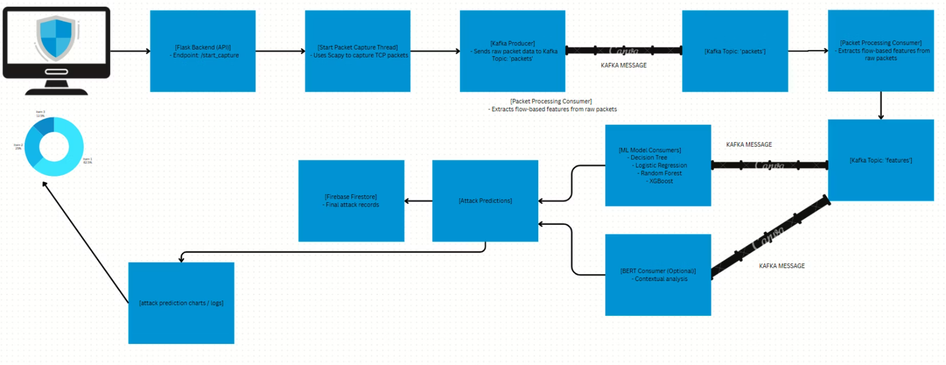
System Architecture :

Slide 12
Technologies Used
Backend Infrastructure: Python, Flask, Kafka, Docker, MongoDB, Firebase Firestore for streaming, storage, and API management.
Packet Capture: Scapy for live network traffic capture and metadata extraction.
Deep Learning: PyTorch and HuggingFace Transformers, including DistilBERT for payload analysis.
Machine Learning Models: Decision Tree, Random Forest, XGBoost, and Logistic Regression for predictions.
Frontend & Visualization: React.js, HTML5, CSS3, JavaScript, Matplotlib, and Flask-CORS for dynamic charts and CORS handling.

Slide 13
Dataset and Feature Engineering
Dataset: Used the CICIDS2017 dataset from Kaggle, offering diverse, realistic network traffic with labeled attack and benign patterns, widely used in IDS research.
Preprocessing: Cleaned missing values, normalized features, and applied label encoding for machine learning compatibility.
Features: Selected 20 key flow-based metrics like packet sizes and durations based on domain knowledge to improve detection accuracy.
Sampling: Applied stratified sampling to maintain class proportions in training and testing sets, enhancing model reliability.

Slide 14
Backend Architecture
Overview
Core Components
Flask backend for real-time intrusion detection
Packet Producer: Captures & streams TCP packets
Uses ML models + DistilBERT for threat classification
Processing Consumer: Extracts flow-based features
Kafka handles streaming; MongoDB & Firebase for storage
ML & BERT Consumers: Predict and classify threats
Technology Stack
Additional Features
Tools: Python, Flask, Kafka, Scapy
REST APIs with CORS
Storage: MongoDB, Firebase
Live donut charts via Matplotlib
Libraries: PyTorch, HuggingFace, Scikit-learn, XGBoost
In-memory logging and structured model loading

Slide 15
Frontend Interface
Overview
React.js frontend for real-time and offline detection
Interfaces with Flask backend via REST APIs
Core Pages
Home: Navigation to Go Live or Test
Go Live: Start/Stop pipeline, live charts, access logs
Logs Page: Displays live predictions and system activity
Test Page: Upload CSV → get predictions, metrics, and charts
Tech Stack
React.js, HTML5, CSS3, JavaScript
Visuals: Donut charts, logs, evaluation metrics

Slide 16
ML Model Development
Dataset & Preprocessing
Dataset: CICIDS2017 (Kaggle)
Cleaned, normalized, encoded labels, and consolidated attack classes
Feature Engineering
Removed redundant features
Selected top 20 relevant features (e.g., Flow Duration, IAT, TCP Flags)
Models Used
Logistic Regression: Fast, weak on rare attacks
Decision Tree: Interpretable, overfits
Random Forest: High accuracy (~0.82 F1), robust
XGBoost: Strong performance, scalable
Training Strategy
Stratified sampling, k-fold validation
Metrics: Accuracy, Precision, Recall, F1, ROC AUC

Slide 17
DistilBERT Training Workflow
Purpose
NLP-based binary classification (benign vs. malicious)
Data Prep & Tokenization
Text + binary_label → HuggingFace Dataset
Tokenized using distilbert-base-uncased (max length: 128)
Training Configuration
90:10 train/eval split (seed 42)
Epochs: 3, Batch size: 16, LR: 2e-5
Evaluated using Trainer with real-time accuracy tracking
Deployment
Model + tokenizer saved to ./distilbert_binary_model
Archived for easy reuse and deployment

Slide 18
Results and Discussions
Model Performance Comparison
Class / Metric
Random Forest
Decision Tree
XGBoost
Logistic Regression
BENIGN
1.00
1.00
1.00
0.92
DDoS
1.00
1.00
1.00
0.51
DoS-Hulk
0.99
0.99
0.99
0.76
FTP-Patator
1.00
1.00
1.00
0.00
PortScan
1.00
0.99
1.00
0.00
SSH-Patator
0.98
0.98
0.98
0.00
Bot
0.59
0.59
0.57
0.00
Web-Attack-SQLi
0.00
0.22
0.57
0.00
Web-Attack-XSS
0.38
0.37
0.03
0.00
Heartbleed
–
0.00
–
0.00
Macro F1-Score
0.82
0.77
0.80
0.16

Slide 19
Results and Discussions
DistilBERT – Evaluation Summary
Metric
Value
Accuracy
96%
Precision
94.02%
Recall
99.09%
F1-Score
96.49%
Evaluation Loss
0.1357
Latency
~0.79 seconds
Throughput
254 samples/second
Model Prep Time
0.0033 seconds
Eval Steps/sec
16.54

Slide 20
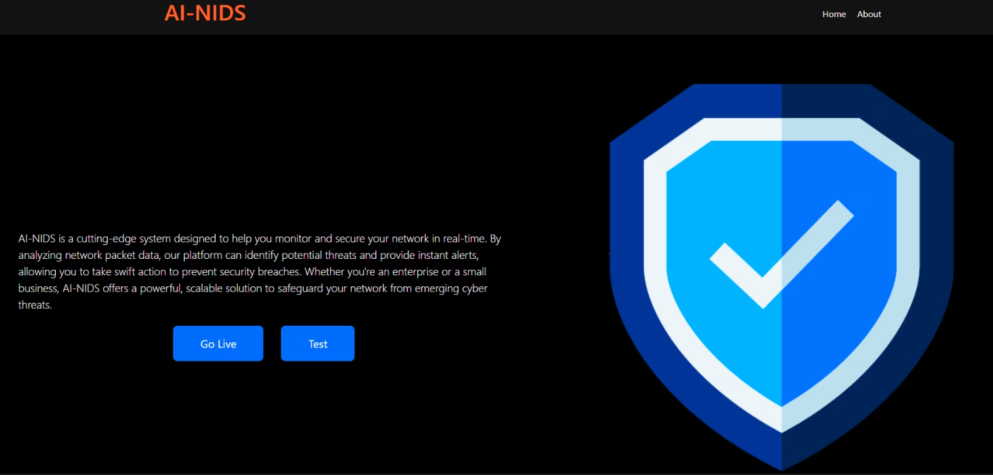
Web App Interface : Home

Slide 21
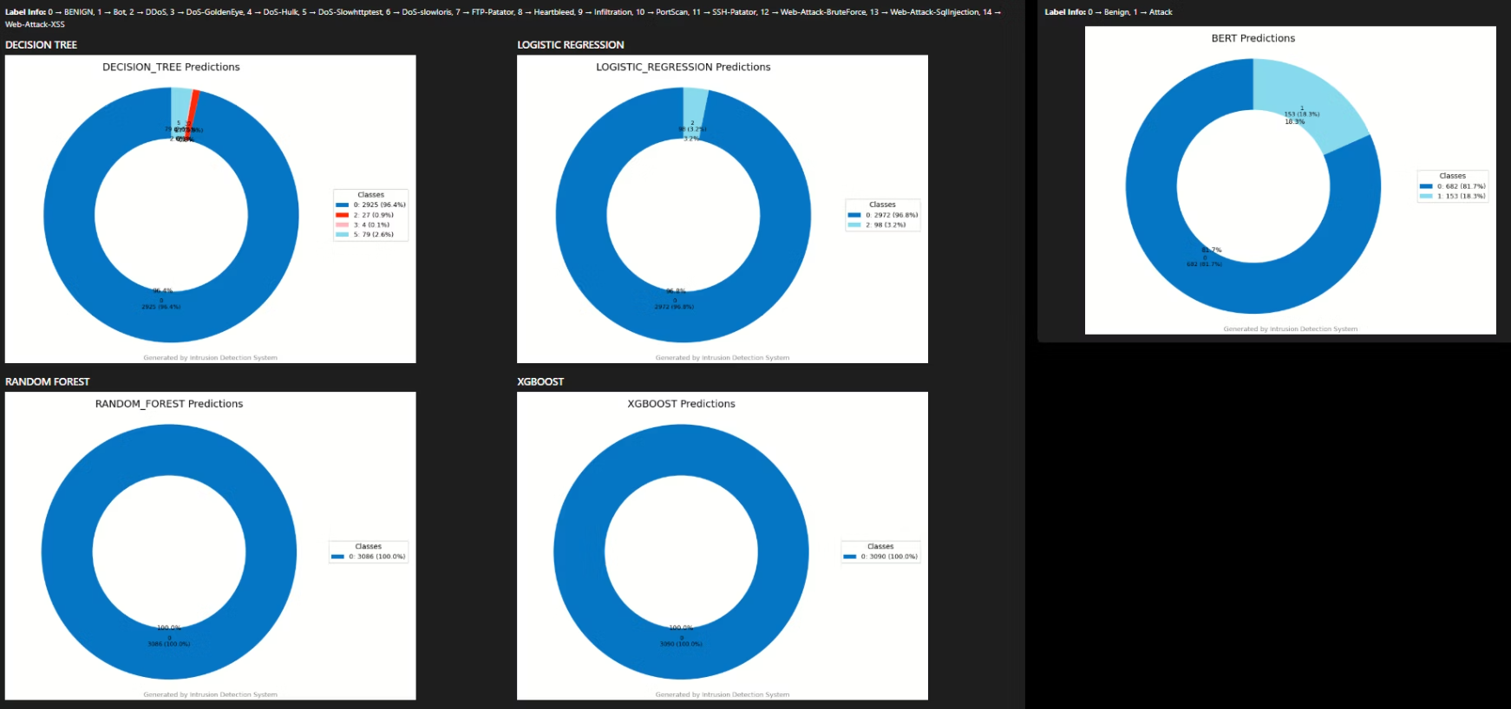
Live Model Predictions

Slide 22
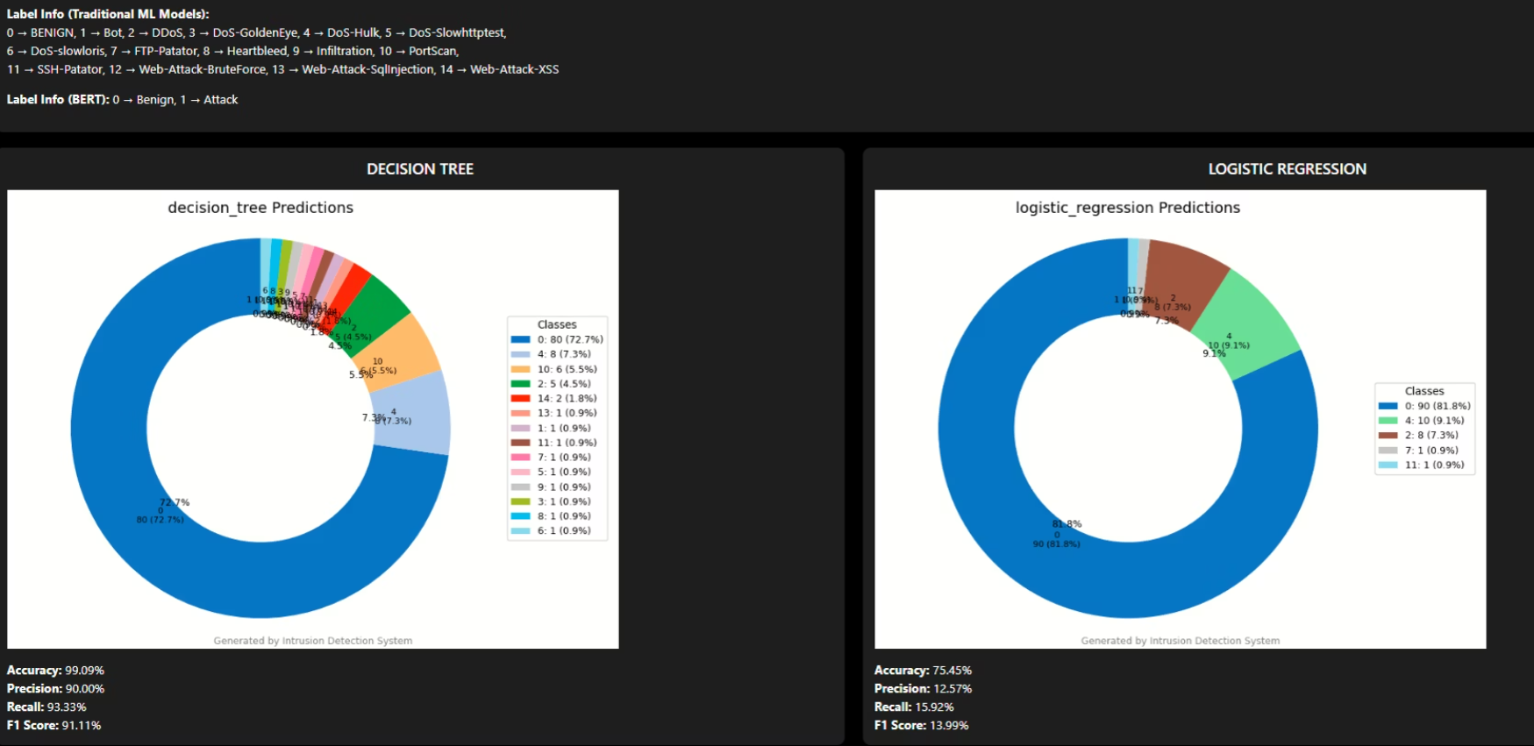
Model Testing

Slide 23
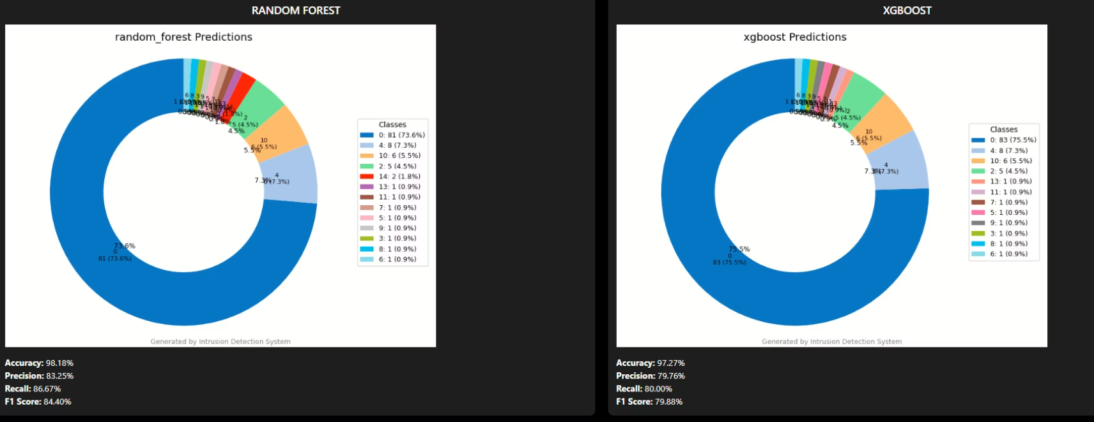
Model Testing

Slide 24
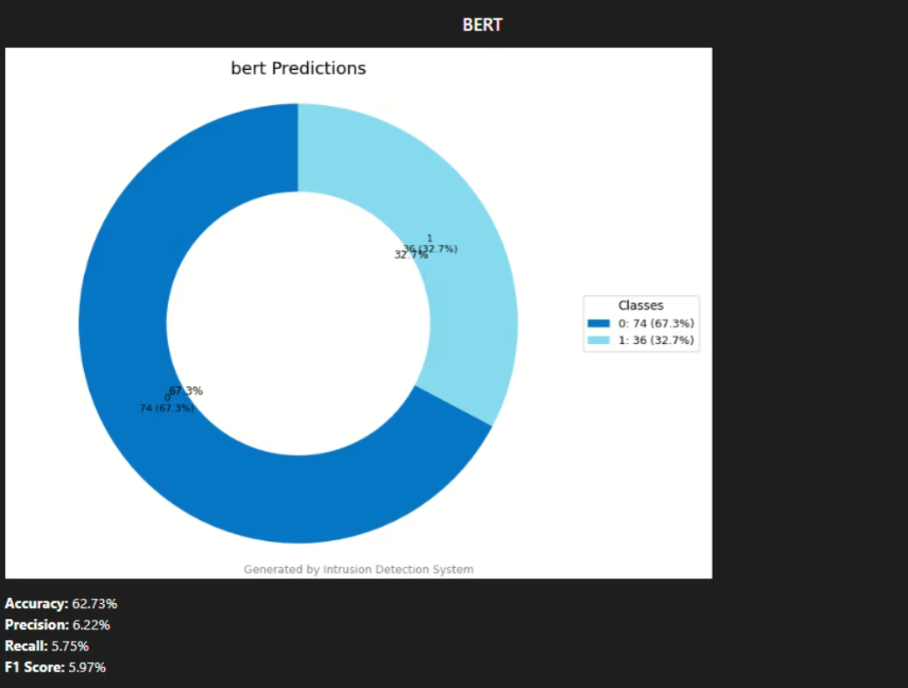
Model Testing

Slide 25
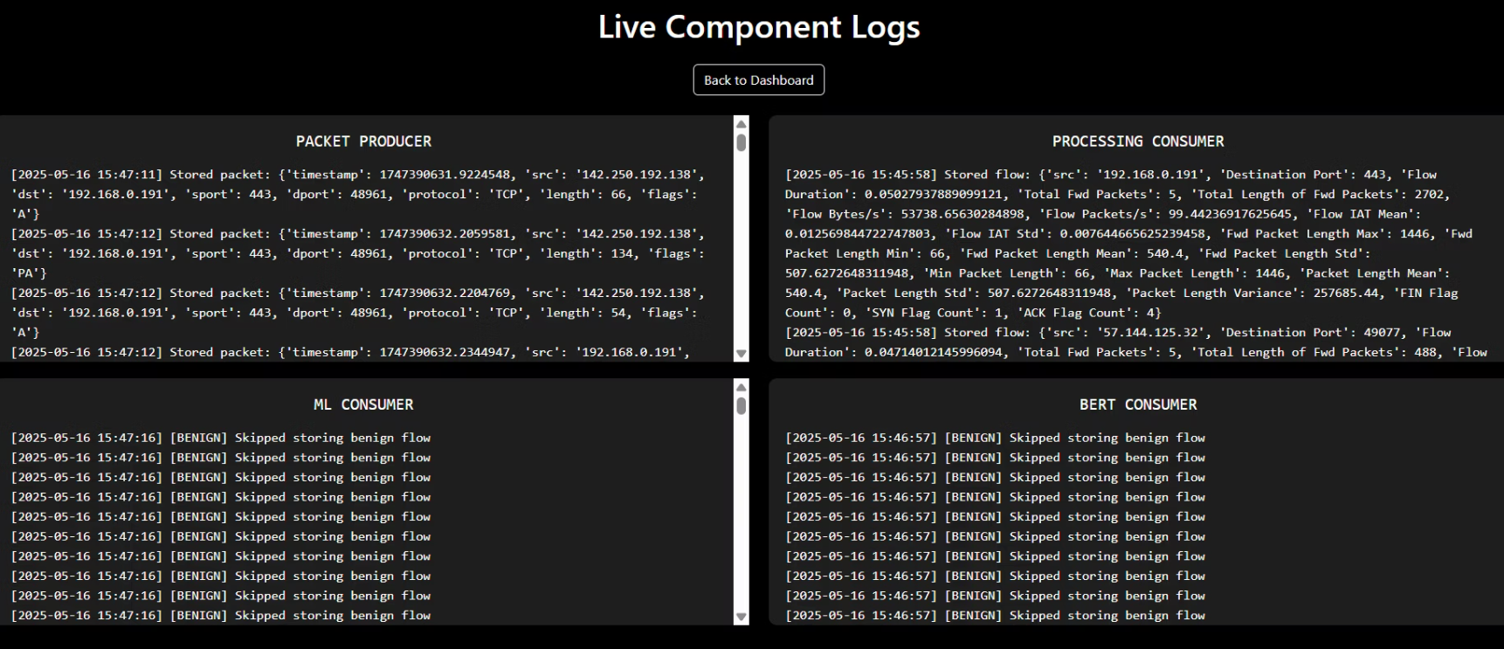
Live Component Logs

Slide 26
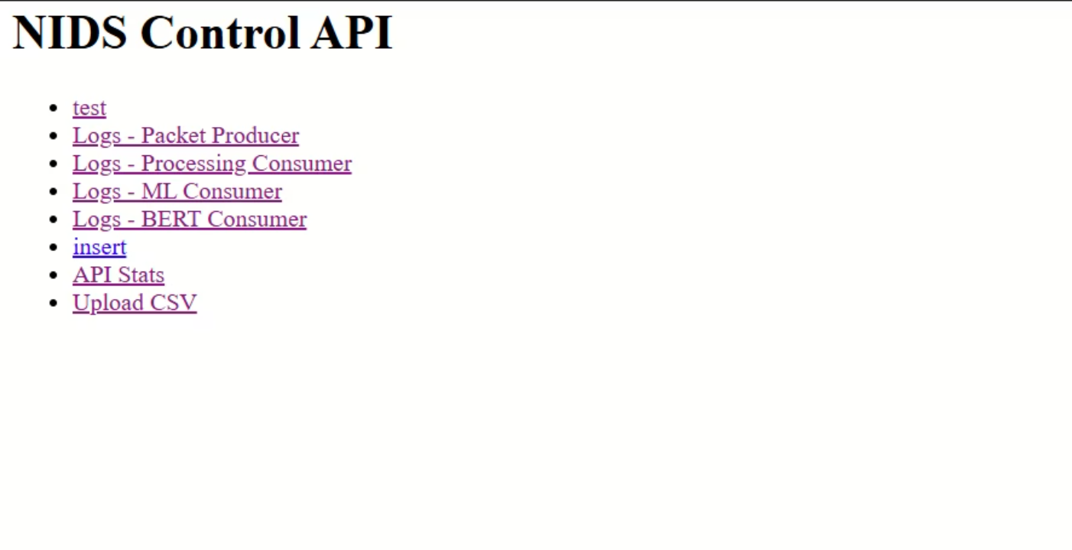
NIDS Control API

Slide 27
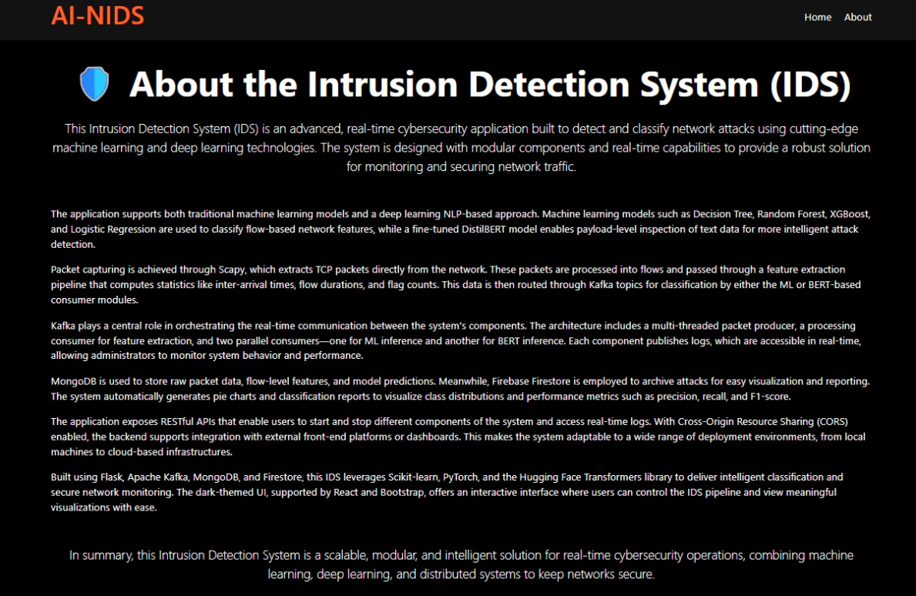
About Page

Slide 28
Challenges and Limitations
Class Imbalance: Rare attacks like XSS and SQLi are underrepresented, causing models to favor common attacks and miss critical threats.
Model Limitations: Logistic Regression handles binary classification well but struggles with multiclass intrusion types, requiring more advanced models.
Feature Gaps: Missing role-based access control and explainable AI in the interface limits security management and user trust.

Slide 29
Future Scope
Address Class Imbalance: Use techniques like GANs and SMOTE to augment data and improve detection of rare attacks, strengthening model robustness.
Explainability Integration: Add tools such as SHAP and LIME to the dashboard for transparent AI predictions, aiding analyst trust and decision-making.
Security Enhancements: Implement role-based access control and user management to restrict sensitive system access and enhance policy compliance.
Performance Optimization: Optimize models for faster inference and lower resource use, enabling deployment on edge and embedded devices without losing accuracy.

Slide 30
Summary and Conclusion
AI-NIDS combines machine learning and deep learning for enhanced, adaptive intrusion detection with higher accuracy than traditional methods.
Using DistilBERT for payload analysis with an ensemble of ML models supports robust, real-time detection across diverse attacks.
Its modular, containerized design ensures scalability for deployments from small businesses to large enterprises.
Feature engineering and a comprehensive dataset improve detection, while addressing class imbalance remains important.
Future work will focus on better detecting rare attacks via advanced data augmentation and adding explainability tools for transparency.
Plans also include interface improvements and role-based access control to boost security management and user trust.
Overall, AI-NIDS advances network security by providing a scalable, accurate, and user-friendly AI-driven intrusion detection solution.

Slide 31
References
https://www.sciencedirect.com/science/article/pii/S2666764924000316
https://ieeexplore.ieee.org/document/10747338
www.researchgate.net/publication/382302921_Artificial_Intelligence_based_Intrusion_Detection_System_-_A_Detailed_Survey
https://www.sciencedirect.com/science/article/pii/S2665917423001630
https://d1wqtxts1xzle7.cloudfront.net

Slide 32
Thank You

